Slide 1
Paper: “Julia as a Unifying End-to-End Workflow Language on the Frontier Exascale System” The 18th Workshop on Workflows in Support of Large-Scale Science (WORKS23)
William F Godoy, Pedro Valero-Lara, Caira Anderson, Katrina W Lee, Ana Gainaru, Rafael Ferreira Da Silva, Jeffrey S Vetter
Oak Ridge National Laboratory

Slide 2
Contents
Motivation, about DOE HPC Facilities
Julia value proposition for HPC
Results on Frontier
Conclusions and Final Thoughts

Slide 3
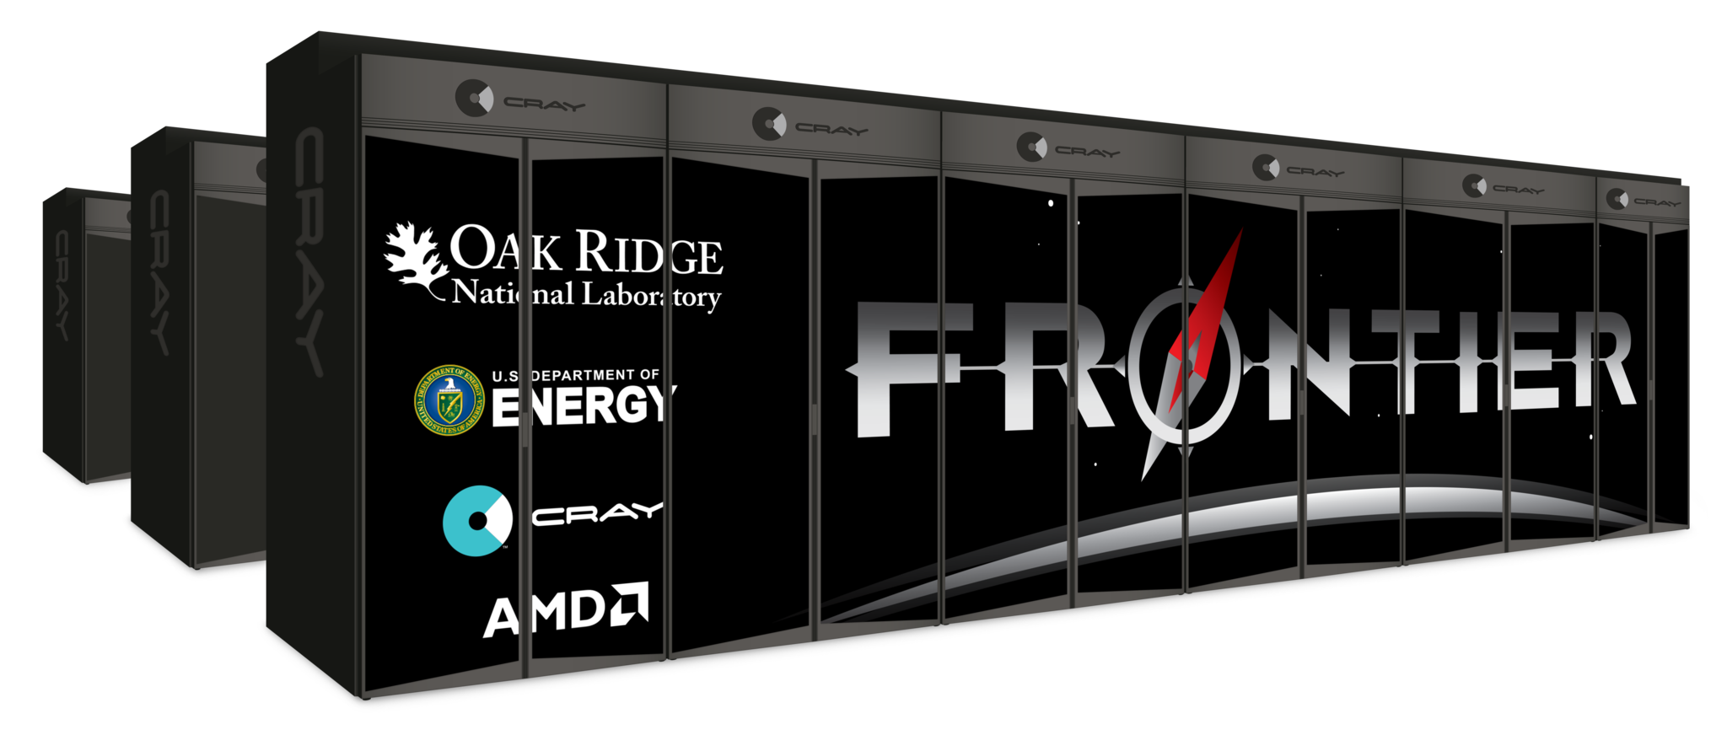
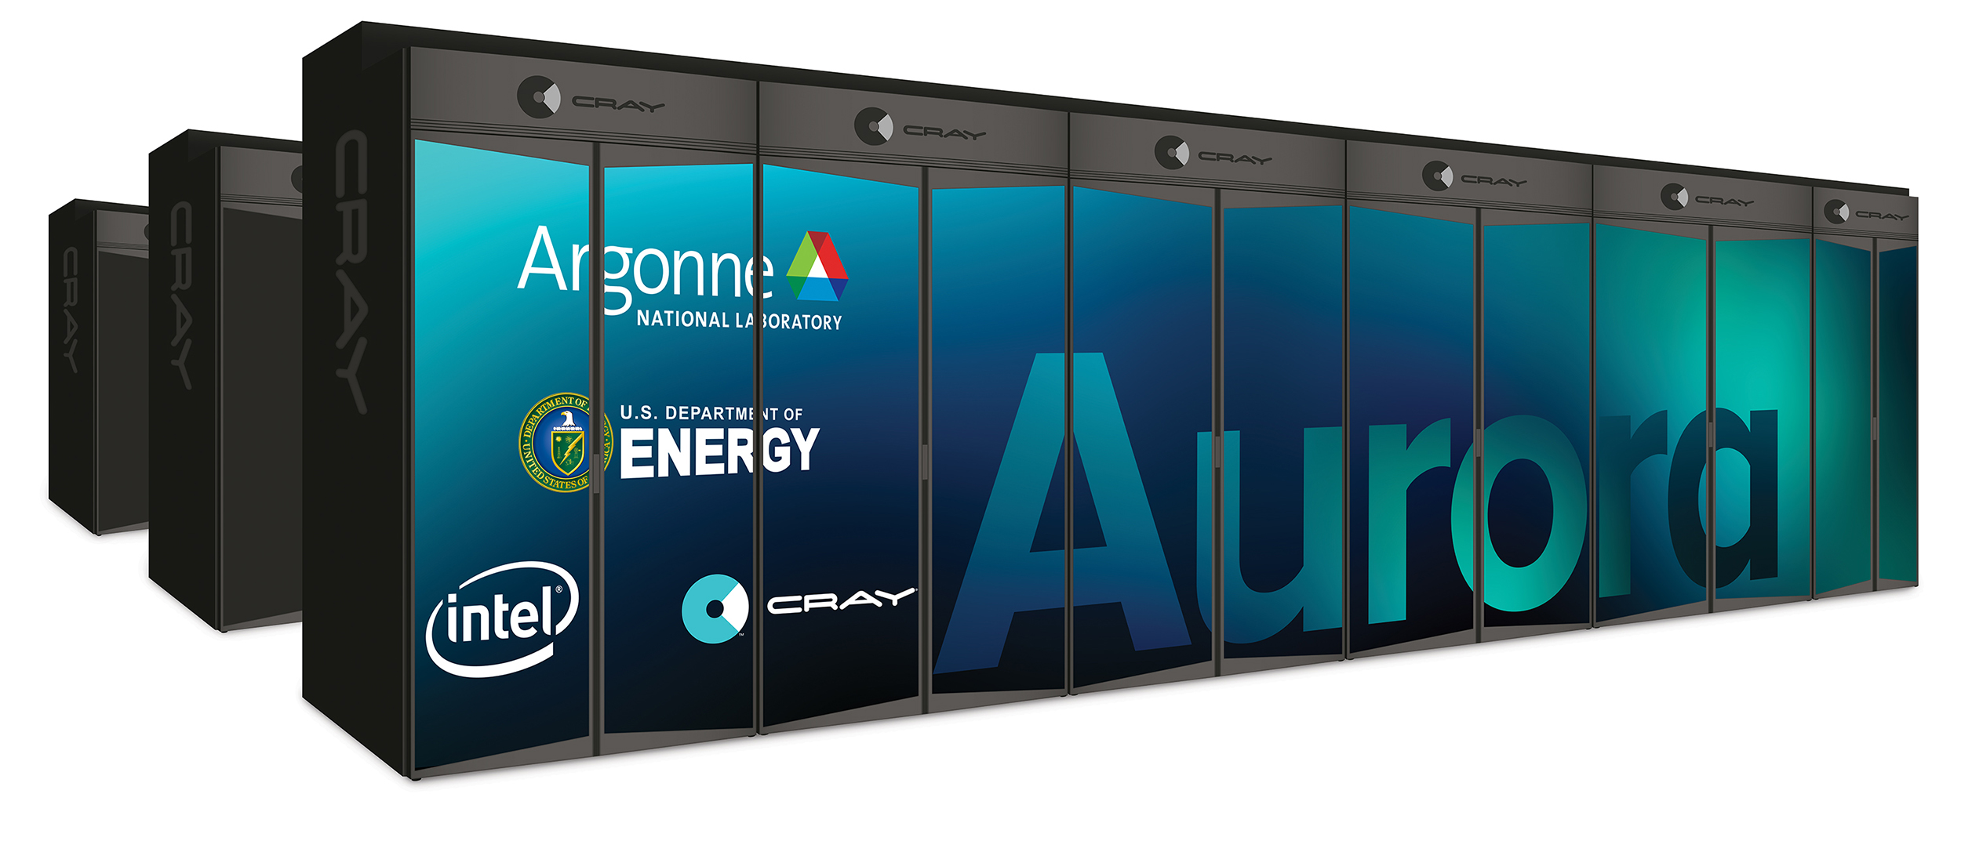
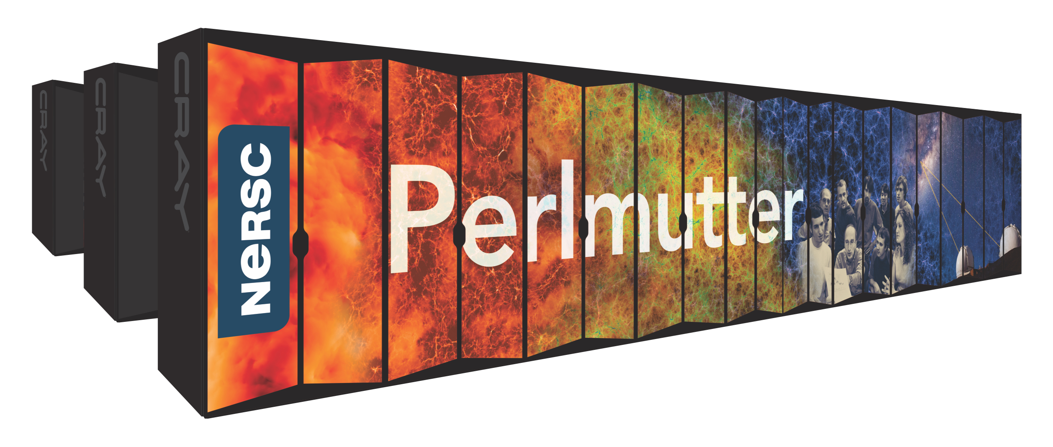
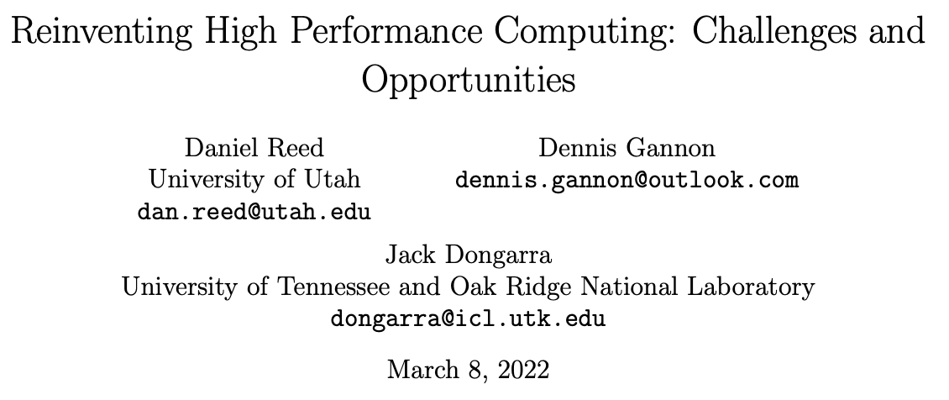
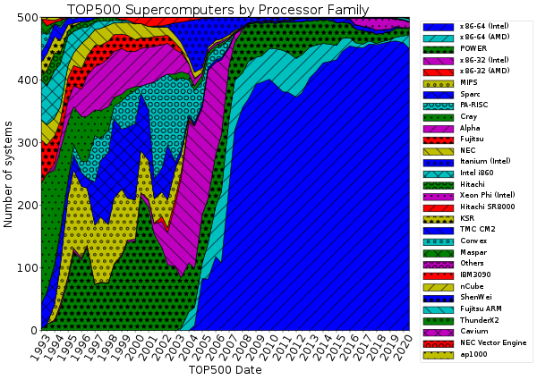
Motivation
https://arxiv.org/abs/2203.02544
The US Department of Energy (DOE) computing user facilities are “heterogeneous” GPU-accelerated systems
Oak Ridge Leadership Computing Facility (OLCF): Summit, Frontier
Argonne Leadership Computing Facility (ALCF): Theta, Aurora (coming soon)
National Energy Research Scientific Computing Center (NERSC): Cori, Pelmutter
We are driven and funded by science https://nationallabs.org/our-labs/what-we-do/
Fortran and CPUs are still very important!
Performant portable layers are a requirement in DOE: e.g. Kokkos, Raja, OpenMP, OpenACC

Slide 4
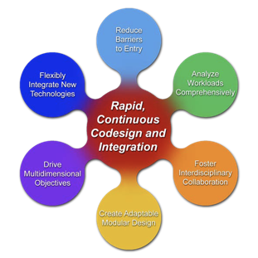
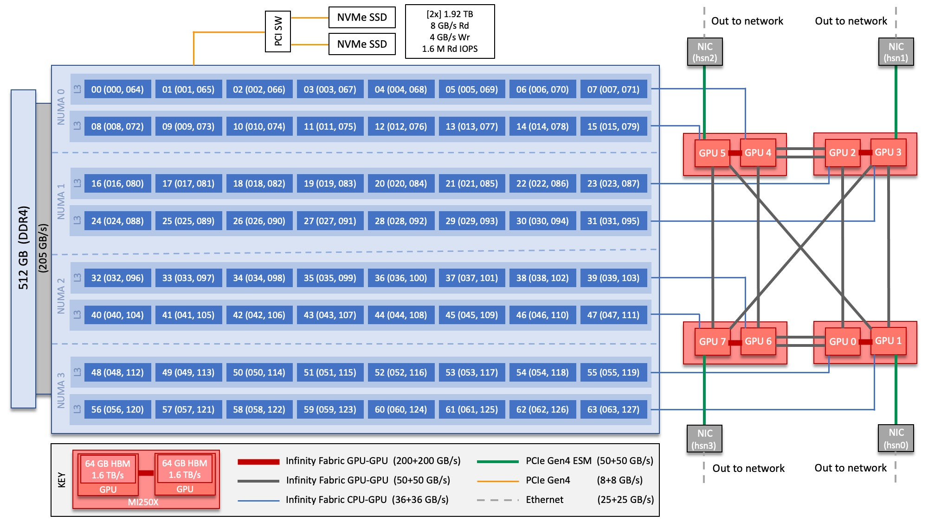
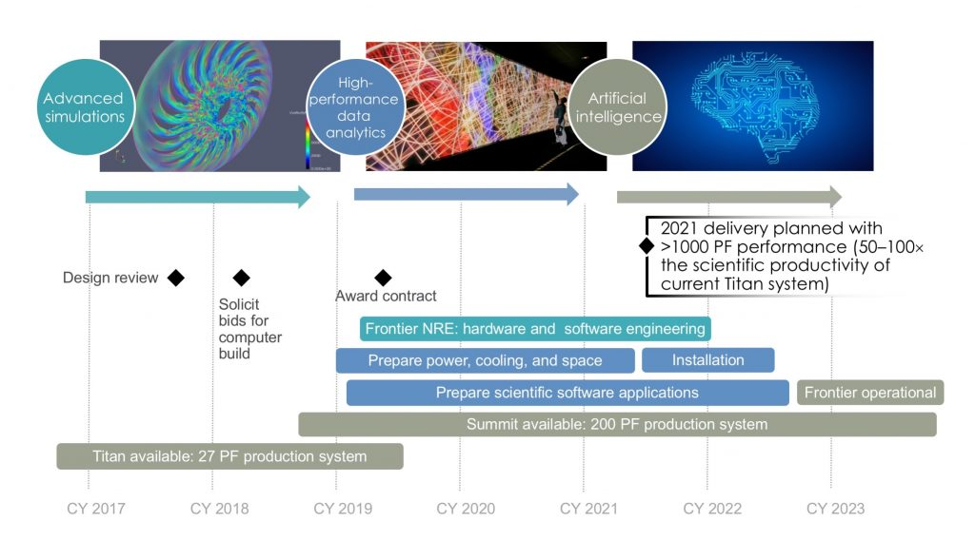
Rethink how we do Computing
Scientific programming is HARD (specially on our Leadership Computing Facilities, LCFs)
Software is our “specialized science equipment” for science
There is still a lot of plumbing to be done
“Can a machine translate a sufficiently rich mathematical language into a sufficiently economical program at a sufficiently low cost to make the whole affair feasible?”---Backus on Fortran (1980)
Programming productivity is always a challenge
Barrier to entry from idea to portable performance
AI/ML+HPC is a multidisciplinary co-design challenge
How to leverage US DOE Exascale Computing Project legacy?
Key question: “What novel approaches to software design and implementation can be developed to provide performance portability for applications across radically diverse computing architectures?” from Reimagining Codesign for Advanced Scientific Computing: Unlocking Transformational Opportunities for Future Computing Systems for Science. DOE Report https://doi.org/10.2172/1822198

Slide 5
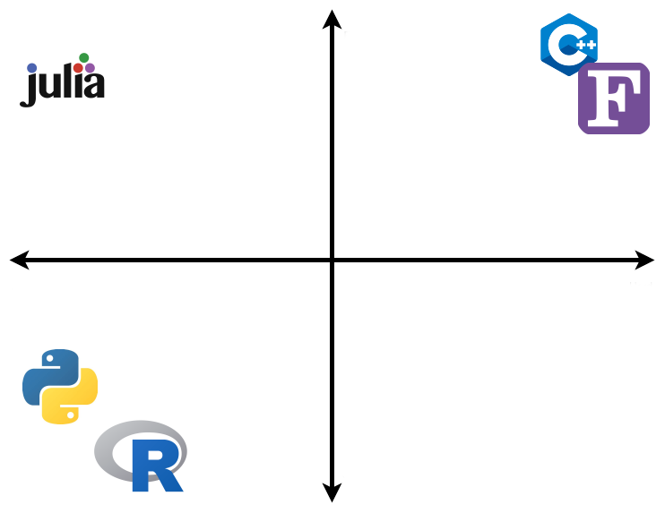

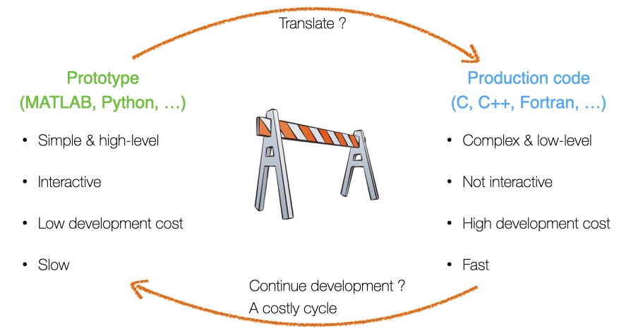
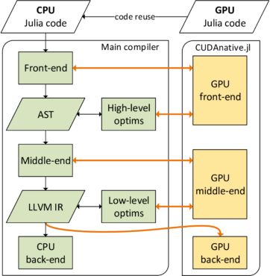
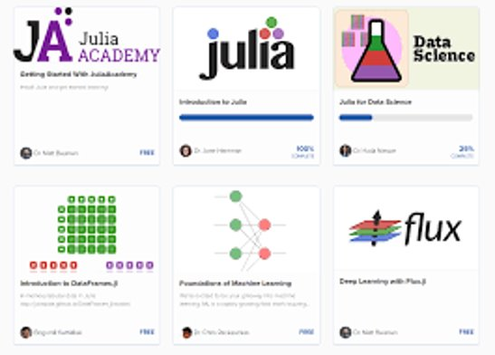
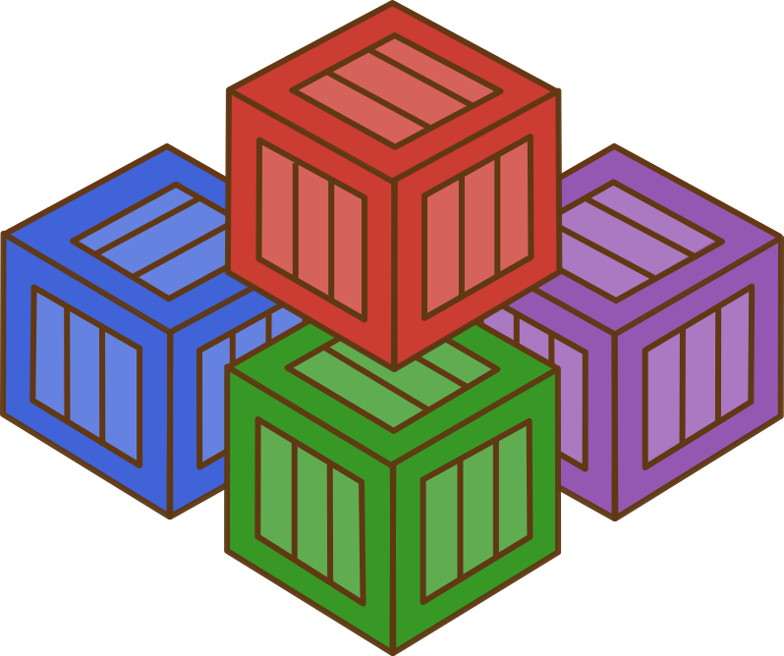
Julia's value proposition for HPC
Designed for “scientific computing” (Fortran-like) and “data science” (Python-like) with performant kernel code via LLVM compilation
Lightweight interoperability with existing Fortran and C libraries
Julia is a unifying workflow language with a coordinated ecosystem
Fast
Easy
Hard
“Julia does not replace Python, but the costly workflow process around Fortran+Python+X, C+X, Python+X or Fortran+X (e.g. GPUs)”
where X = { conda, pip, pybind11, Python, C, Fortran, C++, OpenMP, OpenACC, CUDA, HIP, CMake, numpy, scipy, matplotlib, Jupyter, …}
Slow
https://juliadatascience.io/
Rich data science
ecosystem
LLVM
Pkg.jl
https://pde-on-gpu.vaw.ethz.ch/lecture7
https://developer.nvidia.com/blog/gpu-computing-julia-programming-language/
https://quantumzeitgeist.com/learning-the-julia-programming-language-for-free/

Slide 6
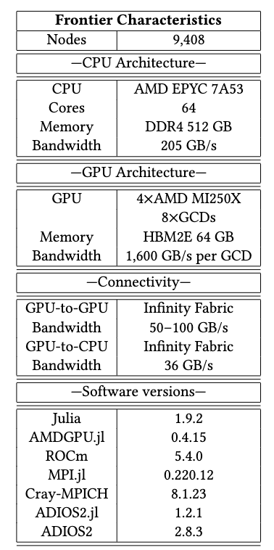
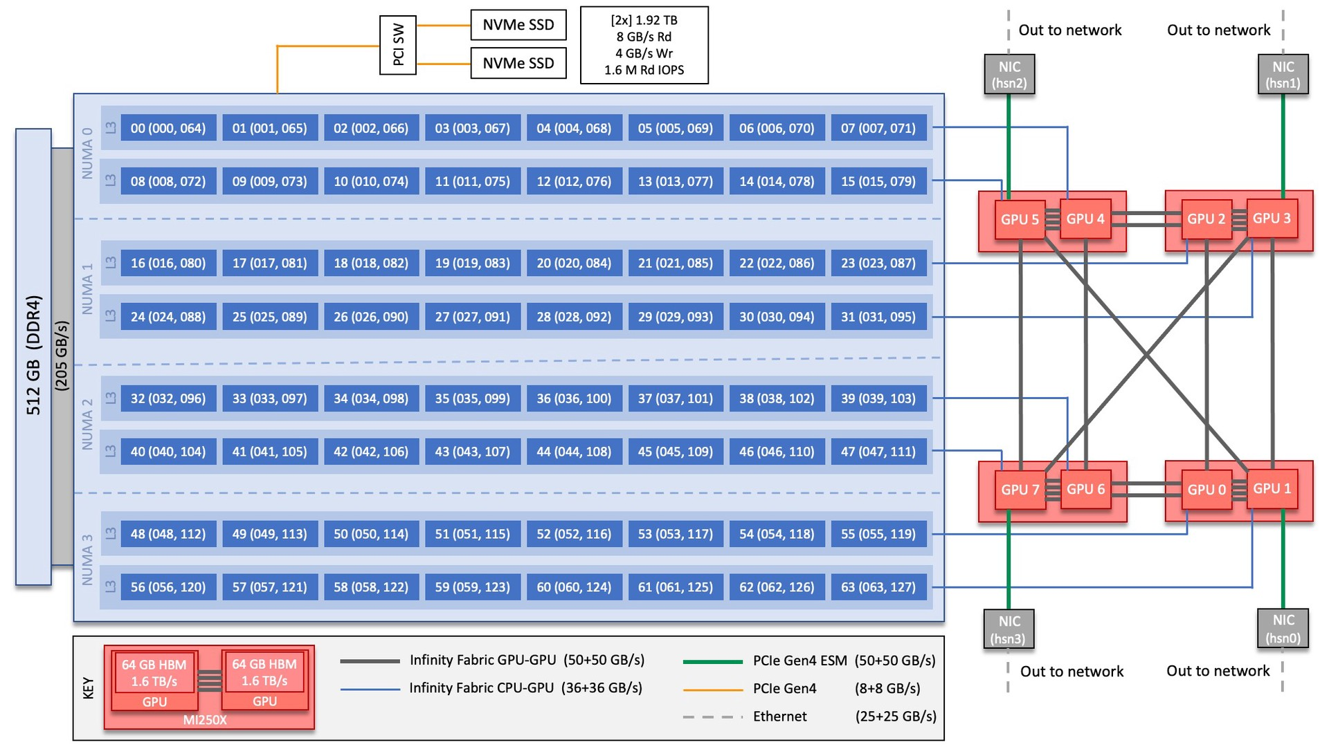
Frontier is a top priority: first exascale supercomputer deployed
https://docs.olcf.ornl.gov/systems/frontier_user_guide.html

Slide 7
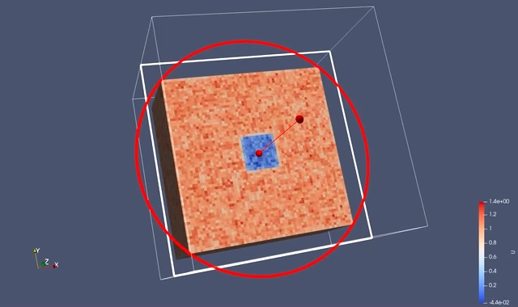
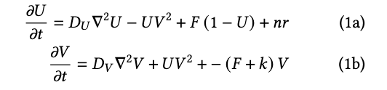
Gray-Scott app: https://github.com/JuliaORNL/GrayScott.jl
Simple 3D 2-variable diffusion-reaction solver
CPU Threads, CUDA.jl and AMDGPU.jl backends using multiple dispatch
Parallel I/O ADIOS2, can be visualized with ParaView
MPI.jl for communication
Configuration and job scripts for Frontier, Crusher and Summit under ./scripts/
Data analysis on JupyterHub
Research Question: Can we write an entire HPC workflow in Julia?
Notes:
Vendor gaps

Slide 8
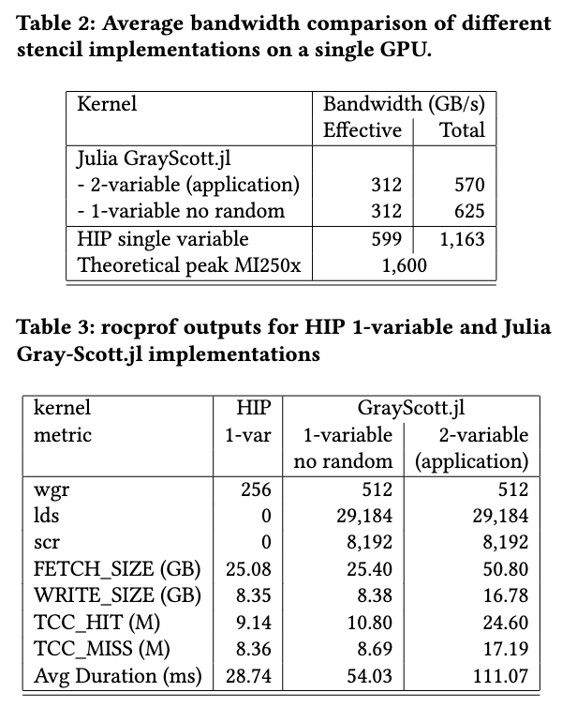
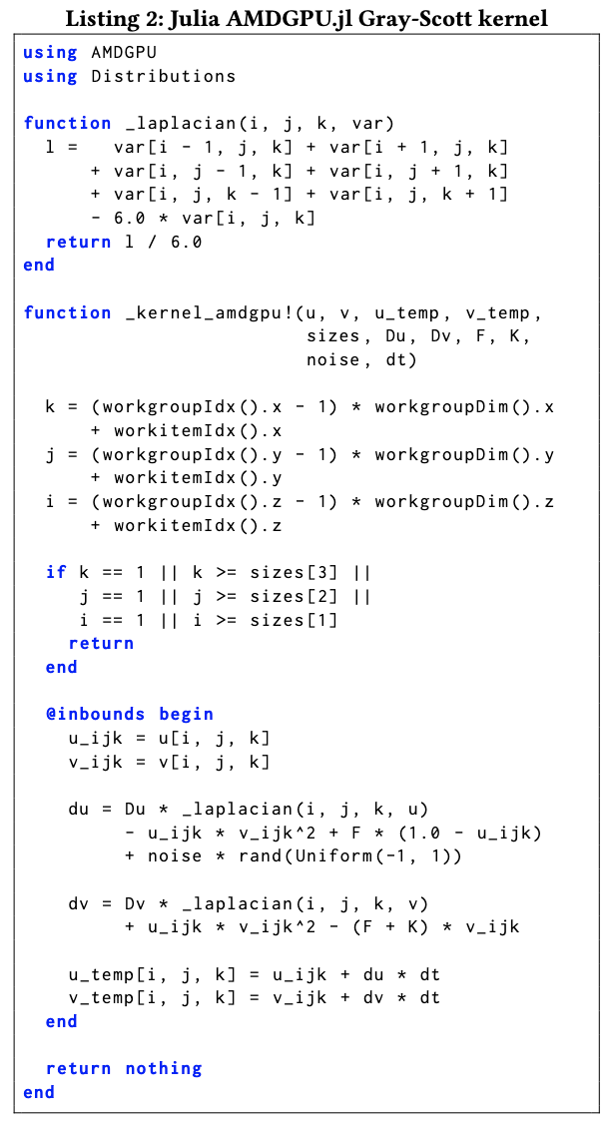
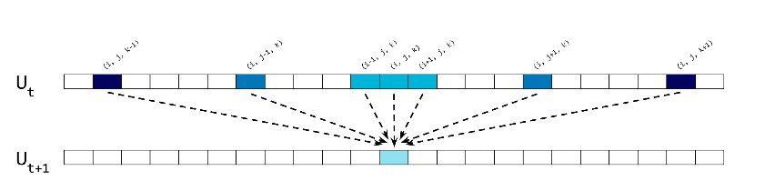
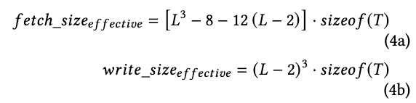
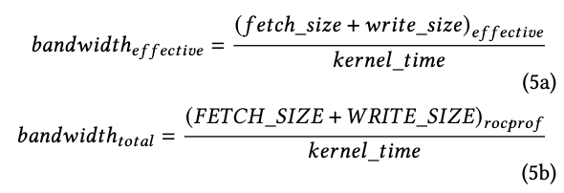
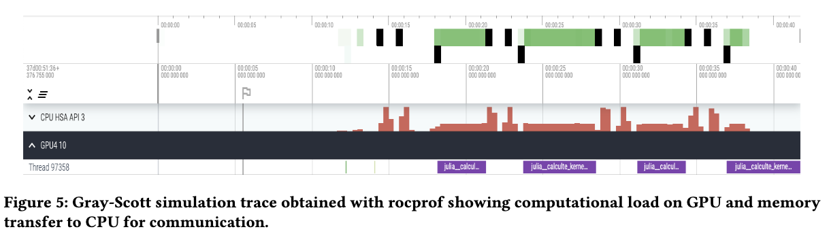
Frontier on-node scalability using AMDGPU.jl
7-point stencil
Notes:
Vendor gaps

Slide 9
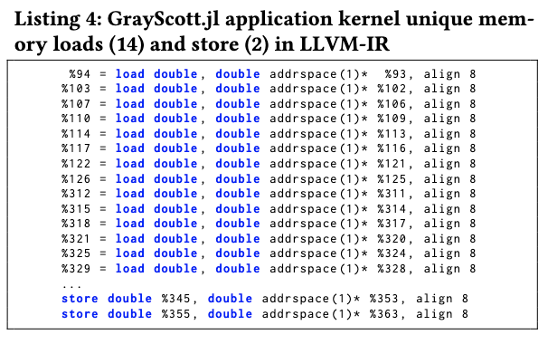
Frontier on-node scalability using AMDGPU.jl
7-point stencil
Julia reaches ~50% bandwidth (performance) of HIP
No surprises on: FETCH/WRITE SIZE, LLVM-IR
rocprof reports more activity “lds” on Julia
Notes:
Vendor gaps

Slide 10
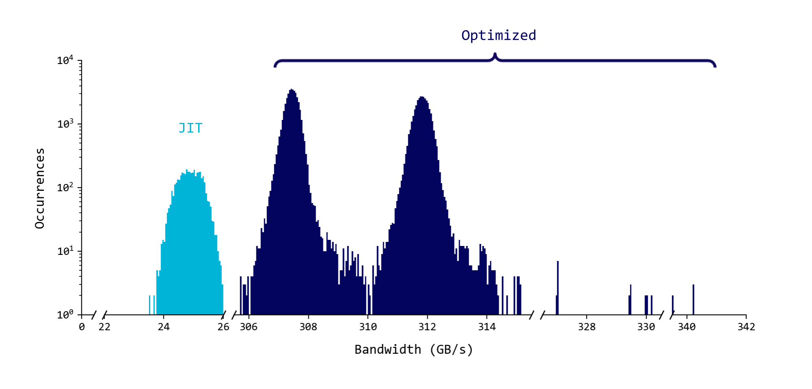
Frontier on-node scalability using AMDGPU.jl for several GPUs
Bandwidth distribution for 4,096 GCD (GPUs) and 20 timesteps. HIP ~ 600 GB/s (800 GB/s claimed on MI250x), Theoretical Peak on MI250x = 1,600 GB/s
Notes:
Vendor gaps

Slide 11
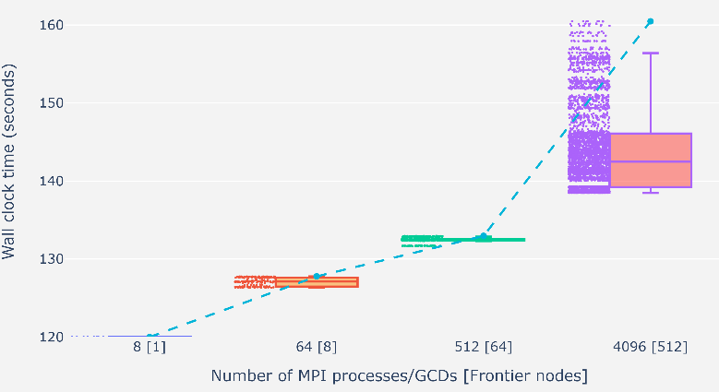
GrayScott.jl Weak Scaling on Frontier
Tested successfully up to 512 nodes (5% of Frontier) 1 GCD/MPI proc using MPI.jl
Tried 4K nodes (50% of Frontier) resulted in a libfabric error
2-3% variability up to 64 nodes
12-15% variability at 512 nodes
Notes:
Vendor gaps

Slide 12
GrayScott.jl Parallel I/O Weak Scaling on Frontier file system
We tested parallel I/O using Julia via the ADIOS2.jl Julia bindings
ADIOS2 is a high-performance data I/O library funded by the US Department of Energy ASCR
Results are shown for the Orion file system
ADIOS2.jl shows negligible overhead
Godoy, W. F., Podhorszki, N., Wang, R., Atkins, C., Eisenhauer, G., Gu, J., ... & Klasky, S. (2020). Adios 2: The adaptable input output system. a framework for high-performance data management. SoftwareX, 12, 100561. https://doi.org/10.1016/j.softx.2020.100561
Notes:
Vendor gaps

Slide 13
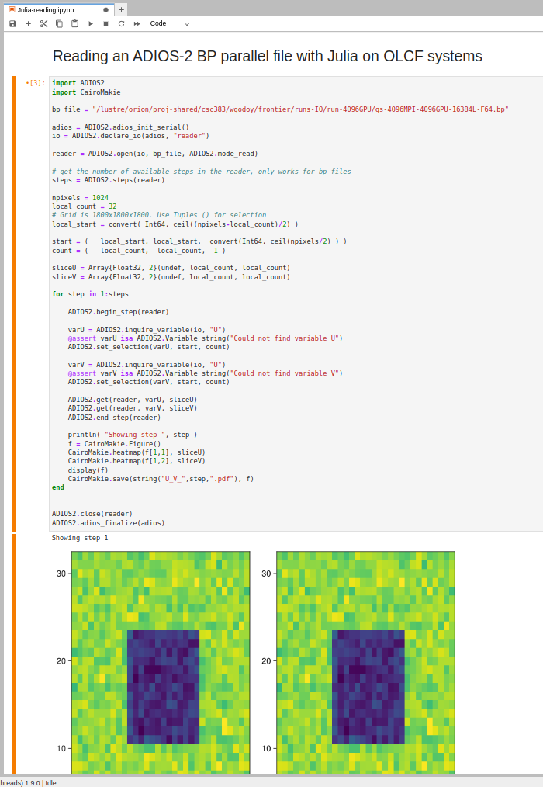
Data analysis on JupyterHub at OLCF
https://jupyter.olcf.ornl.gov/
We launched a Julia kernel on JupyterHub to read and analyze data
We read with ADIOS2.jl and visualize with Makie.jl
JIT and TTFX (time to first plot) can be a nuance
Godoy, W. F., Podhorszki, N., Wang, R., Atkins, C., Eisenhauer, G., Gu, J., ... & Klasky, S. (2020). Adios 2: The adaptable input output system. a framework for high-performance data management. SoftwareX, 12, 100561. https://doi.org/10.1016/j.softx.2020.100561
Notes:
Vendor gaps

Slide 14
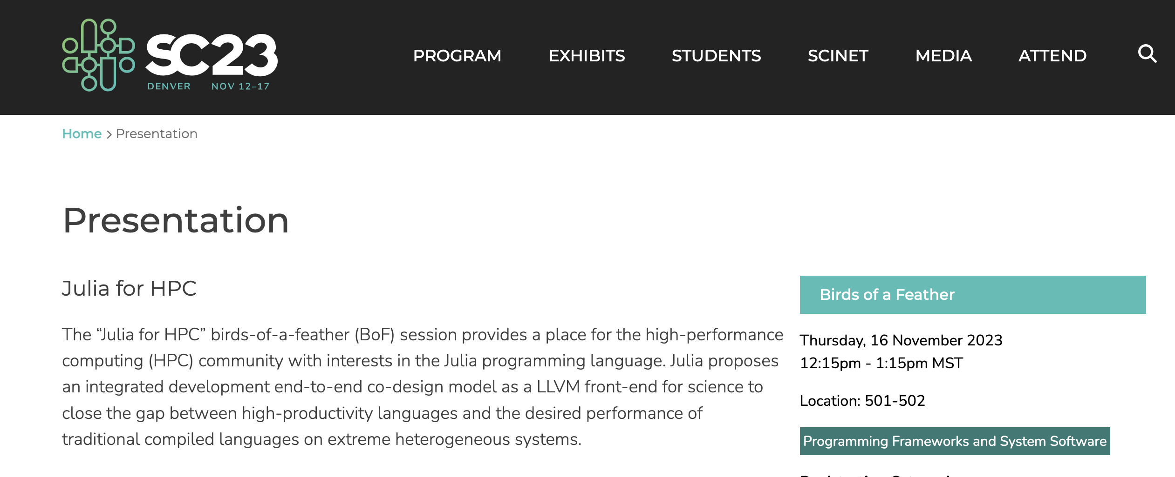

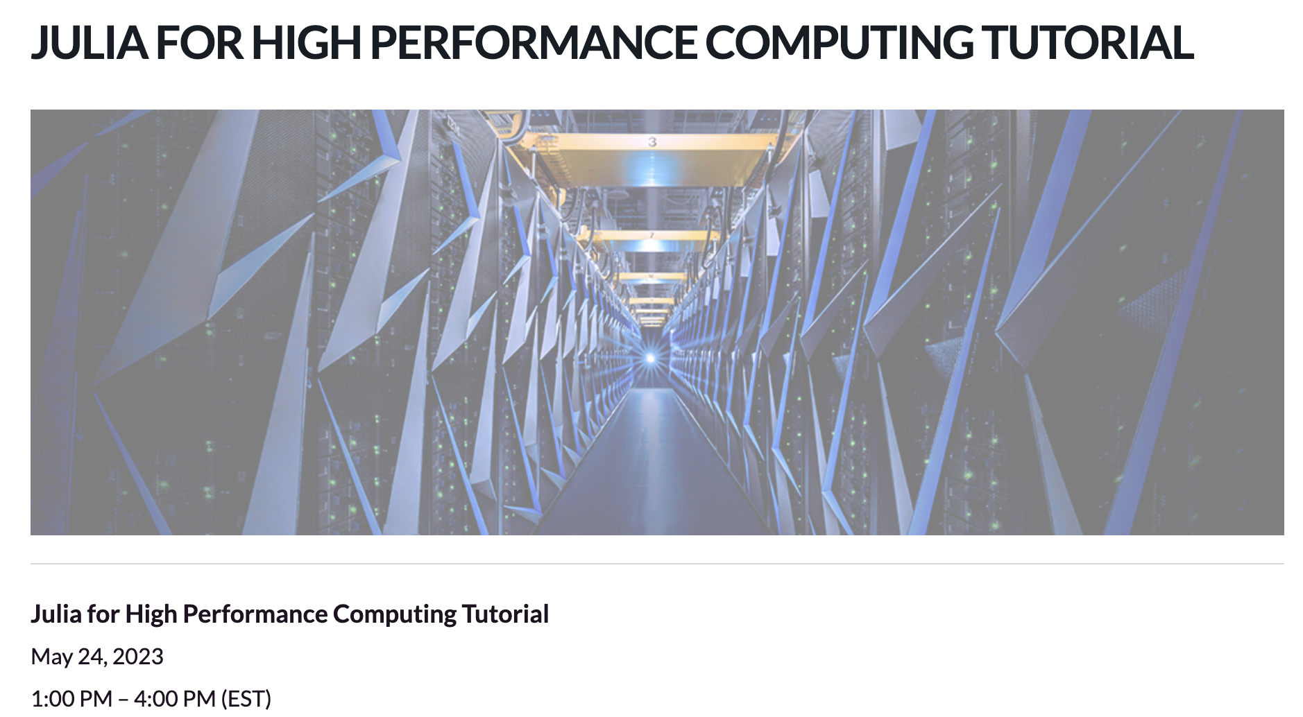
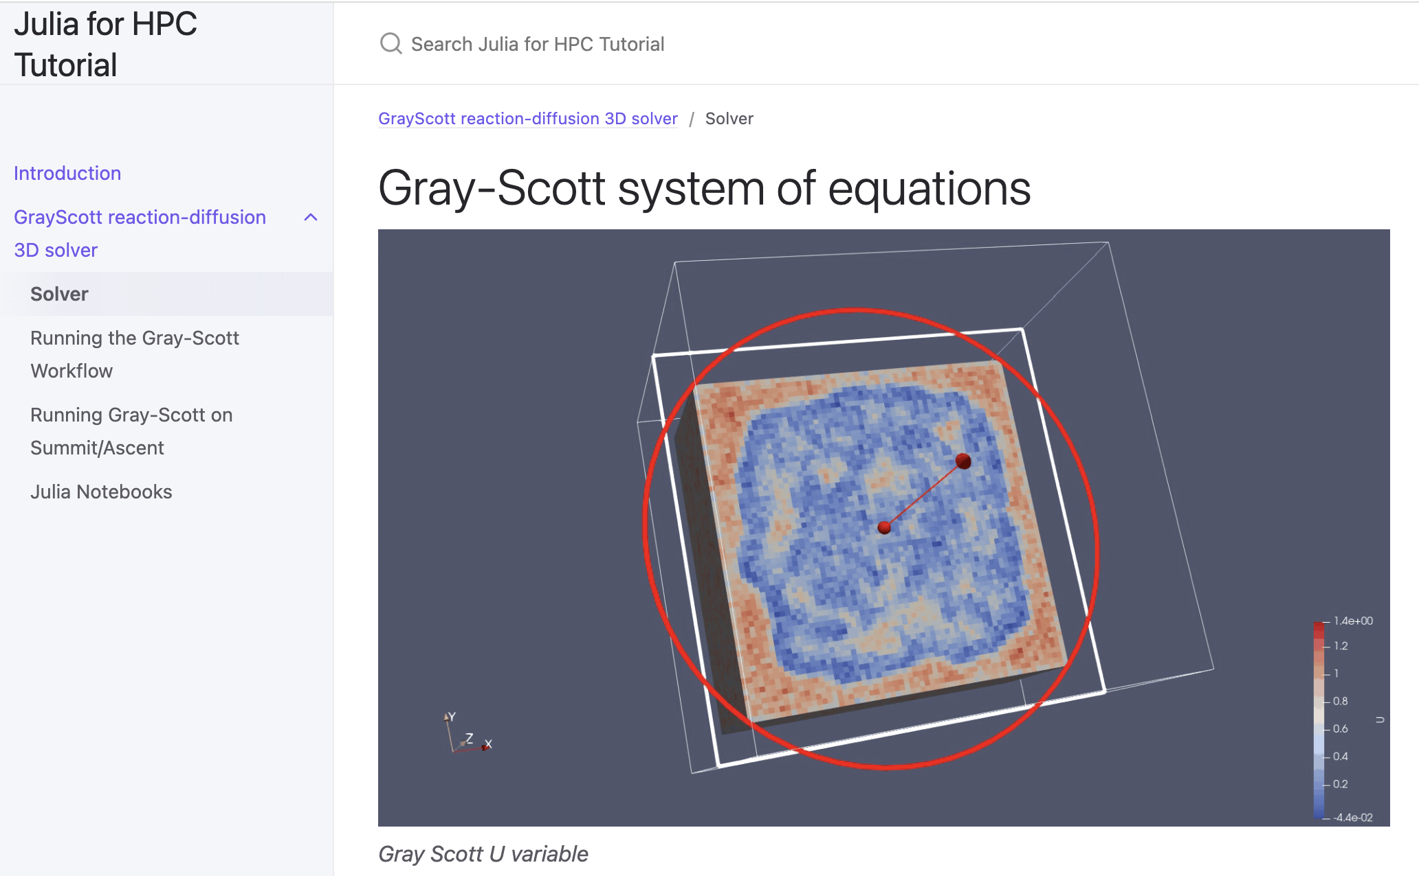
Conclusions and Future Work
Julia for HPC Birds of a Feather at SC23 (Thursday) and Research Poster (Tuesday)
We demonstrated the use of Julia as a unifying end-to-end workflow language on Frontier
Julia is currently at 50% for AMD MI250x GPU performance using a 7-point stencil on Frontier
MPI scalability still uncertain on Frontier beyond 512 nodes (total ~ 9K)
Julia has a lot of potential for HPC use: proxy app, rapid prototyping, unifying ecosystem, productivity, AI workflows
Efforts around Julia and Generative AI using large language models - LLMs
https://juliaornl.github.io/TutorialJuliaHPC/
Possible on Frontier, gaps to be closed

Slide 15

ACKNOWLEDGMENTS
This research was supported by the Exascale Computing Project (17-SC-20-SC), a joint project of the U.S. Department of Energy’s Office of Science and National Nuclear Security Administration, responsible for delivering a capable exascale ecosystem, including software, applications, and hardware technology, to support the nation’s exascale computing imperative. This work is funded, in part, by Bluestone, a X-Stack project in the DOE Advanced Scientific Computing Office with program manager Hal Finkel.
This research used resources of the Oak Ridge Leadership Computing Facility (OLCF) and the Experimental Computing Lab (ExCL) at the Oak Ridge National Laboratory, which is supported by the Office of Science of the U.S. Department of Energy under Contract No. DE-AC05-00OR22725.
The Exascale Computing Project, PROTEAS-TUNE sub-project.
The ASCR Bluestone Project
The OMNI Technology Alliance and Sustainable Research Pathways (SRP) Internship Programs
Julia packages stewards: Julian Samaroo, Valentin Churavy, Tim Besard, Simon Byrne, Lucas Wilcox, Erik Schnetter
and the Julia for HPC community members
Thanks to the audience and WORKS org

Slide 16
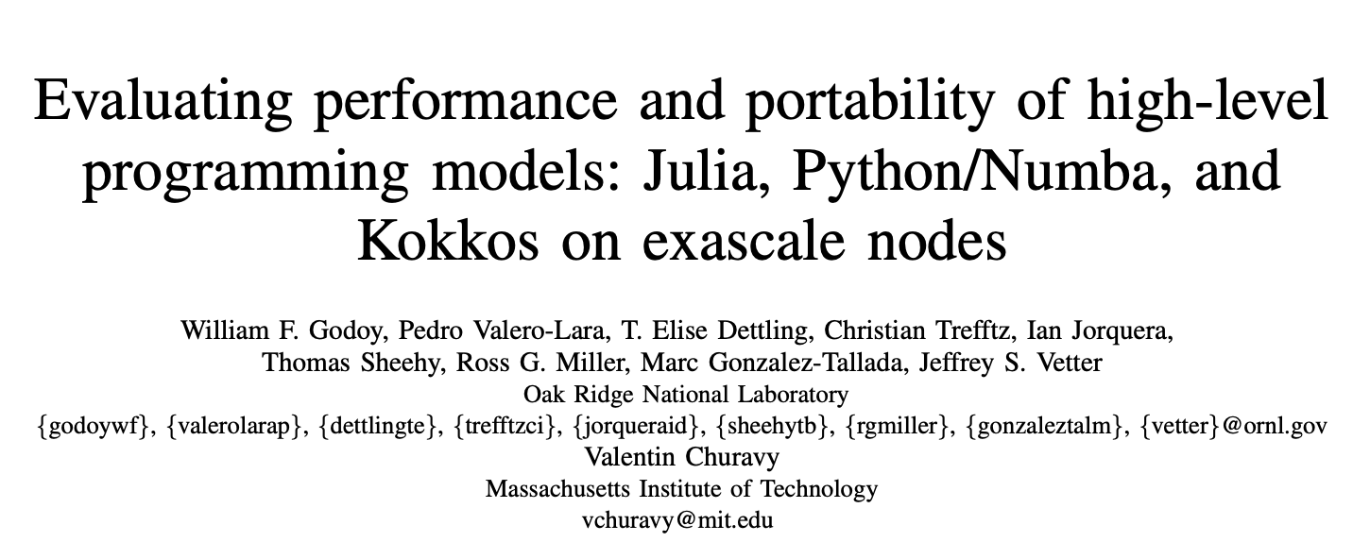
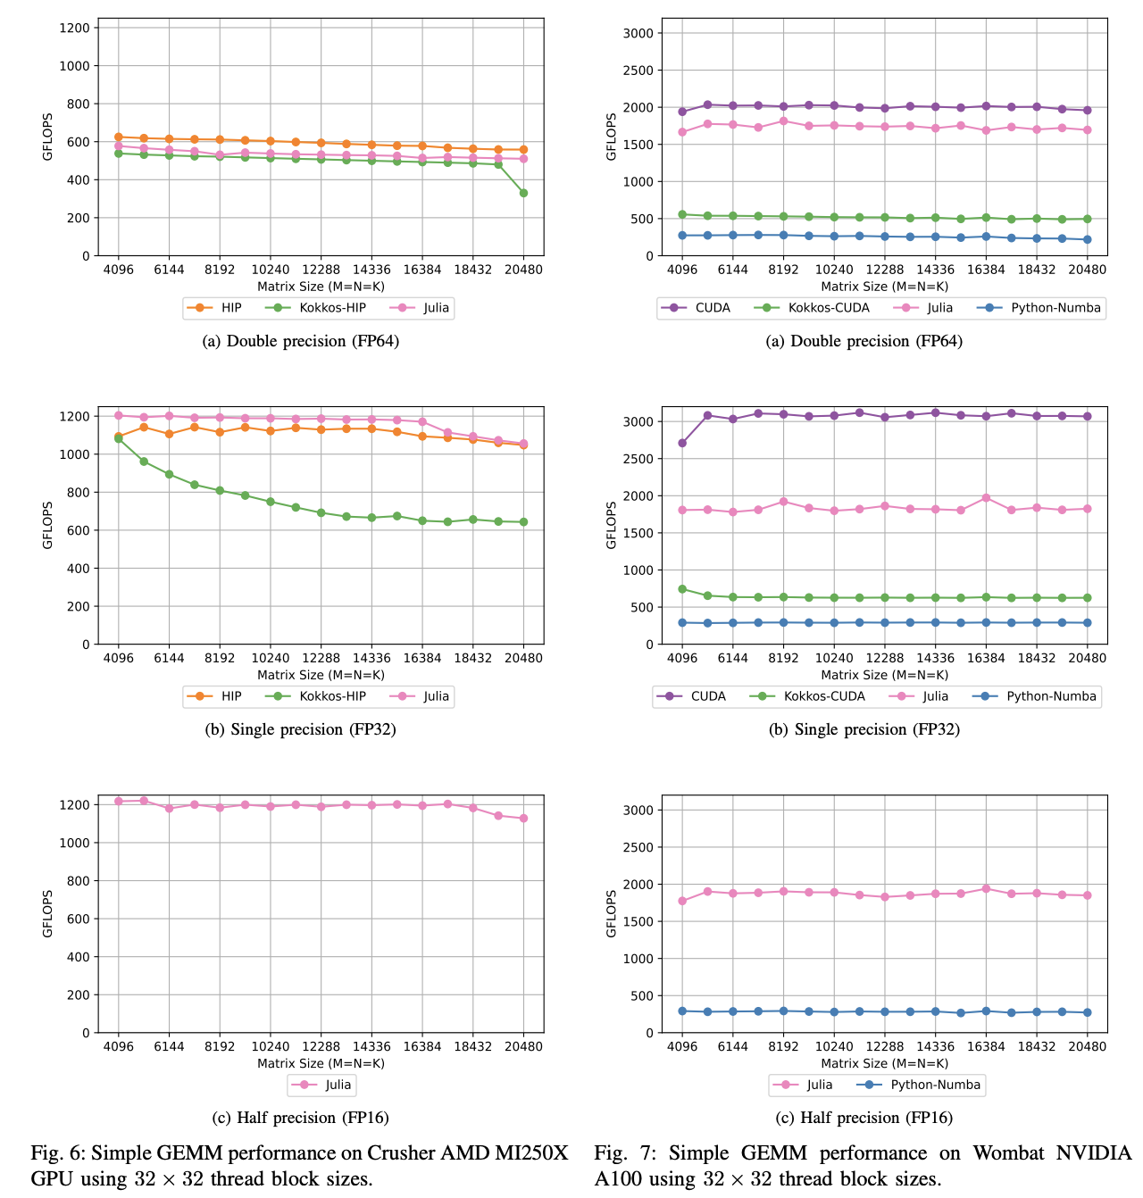
Performance results on GPU for Matrix-Matrix Multiplication
NVIDIA A100 (Wombat/
Pelmutter)
AMD MI250x (Frontier)
Presented at IPDPS 2023 HIPS workshop https://hips2023.github.io/
Pre-print: https://arxiv.org/abs/2303.06195
AMDGPU performance is closer to vendor implementation: LLVM
fma instructions differ in NVHPC and Julia and Kokkos
Python Numba dropped support on AMD GPU
FP16 supported natively by Julia and partially by Numba/Numpy, e.g. random numbers fail
Numba not performing “out-of-the-box”
Reproducibility artifact: https://github.com/williamfgc/simple-gemm/tree/main/scripts/julia

